Slide 1
Online Social Network Event Extraction from Twitter

Slide 2
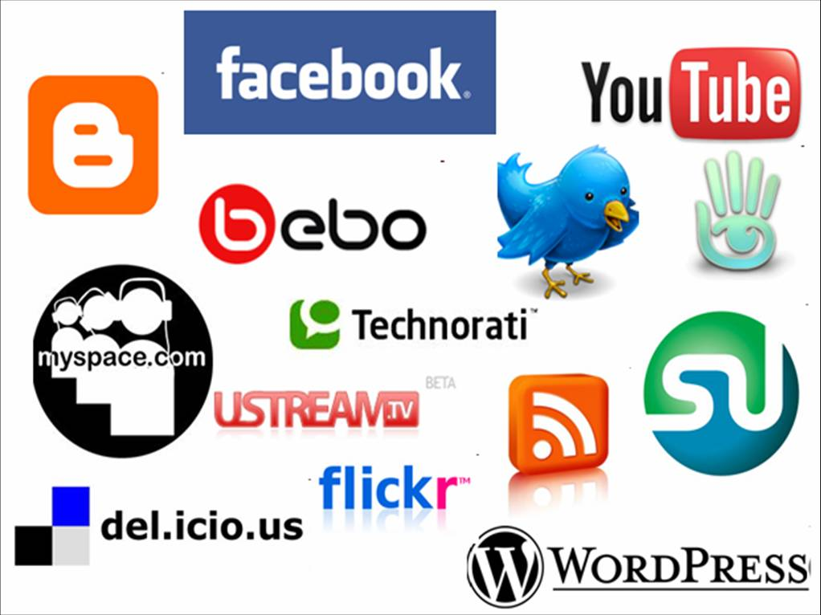
Online Social Network
Online Social Network sites such as Facebook and Twitter are widely used nowadays.
The number of tweets posted daily has recently exceeded two-hundred million.

Slide 3
Research On Twitter Event
Messages in twitter present the most up-to-date information and buzz about current events.
Many research works have been done on extraction event from twitter
Twitter catches the flu: detecting influenza epidemics using Twitter. Aramaki, E., Maskawa, S., & Morita, M. EMNLP 2011
Earthquake shakes Twitter users: real-time event detection by social sensors. Sakaki, T., Okazaki, M., & Matsuo, Y. (2010, April). WWW1010
….

Slide 4
Open Domain Event Extraction from Twitter
Alan Ritter
Mausam, Oren Etzioni, Sam Clark
University of Washington

Slide 5
Goal: Realtime Stream of Structured Information About Events
Raw Tweets Text
extracts a 4-tuple representation of events which
includes a named entity, event phrase, calendar date, and
event type

Slide 6
Background of Event Extraction: Event Extraction from Newswire
Historically, the most important source of info on current events
Since spread of printing press
Lots of previous work on Newswire
Timebank
MUC & ACE competitions
Limited to narrow domains
Performance is still not great

Slide 7
Social Network
Competing source of info on current events
Status Messages
Short
Easy to write (even on mobile devices)
Instantly and widely disseminated
However, it suffers from information overload
Many irrelevant messages
Many redundant messages

Slide 8
NLP in News vs. Twitter: Thought Experiment
In news
Read each sentence from today’s New York times
Answer basic questions about today’s news
Well written passages
In twitter
Read a random sample of tweets
Order is picked randomly
Answer basic questions about today’s news
Noisy Text: Informal text and grammar

Slide 9
System Overview
First, the tweets are POS tagged
POS means Part of Speech tag. It will mark each word to a particular part of speech, such as nouns, verbs, adjectives, adverbs, etc.

Slide 10
System Overview
Second, Named entities and event phrases are extracted, temporal expressions resolved
Named-entity recognition (NER) classify atomic elements in text into predefined categories such as the names of persons, organizations, locations. Here Named entities are almost participant in the event
Event phrases is the phrase that represent the event
Temporal expressions indicate when the event occur

Slide 11
System Overview
Third, the extracted events are categorized into types
Finally, measure the strength of association between each named entity and date based on the number of tweets they co-occur in, in order to determine whether an event is significant

Slide 12
Noisy Text: Challenges
Lexical Variation (misspellings, abbreviations)
`2m', `2ma', `2mar', `2mara', `2maro', `2marrow', `2mor', `2mora', `2moro', `2morow', `2morr', `2morro', `2morrow', `2moz', `2mr', `2mro', `2mrrw', `2mrw', `2mw', `tmmrw', `tmo', `tmoro', `tmorrow', `tmoz', `tmr', `tmro', `tmrow', `tmrrow', `tmrrw', `tmrw', `tmrww', `tmw', `tomaro', `tomarow', `tomarro', `tomarrow', `tomm', `tommarow', `tommarrow', `tommoro', `tommorow', `tommorrow', `tommorw', `tommrow', `tomo', `tomolo', `tomoro', `tomorow', `tomorro', `tomorrw', `tomoz', `tomrw', `tomz‘
Unreliable Capitalization
“The Hobbit has FINALLY started filming! I cannot wait!”
Unique Grammar
“watchng american dad.”

Slide 13
When applying Off The Shelf NLP Tools

Slide 14
Off The Shelf NLP Tools Fails
Twitter Has Noisy & Unique Style

Slide 15
Annotating POS and Named Entities
Annotated 2400 tweets (about 34K tokens)
Train on in-domain data

Slide 16
Learning
Sequence Labeling Task
Begin-Inter-Outside encoding
Tool Conditional Random Fields
Features:
Orthographic
Dictionaries
Contextual
Word | Label
T-Mobile | B-ENTITY
to | O
release | O
Dell | B-ENTITY
Streak | I-ENTITY
7 | I-ENTITY
on | O
Feb | O
2nd | O

Slide 17
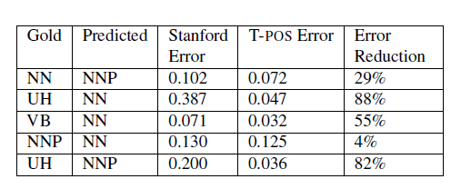
Performance (POS tagger)

Slide 18
Performance (NE Segmentation)

Slide 19
Event-Referring Phrases
Useful to display in connection with events
E.g. “Steve Jobs” + “died” + “October 6”
Helpful in categorizing Events into Types
Examples:
Apple to Announce iPhone 5 on October 4th! YES!
iPhone 5 announcement coming Oct 4th
WOOOHOO NEW IPHONE TODAY! CAN’T WAIT!

Slide 20
Event Phrases: Annotation/Learning
Annotated 1,000 tweets (19,484 tokens)
Similar to EVENT tags in TimeBank
Sequence-labeling problem
IOB Encoding
Conditional Random Fields

Slide 21
Event Phrases: Features
Contextual features
POS tags
Adjacent words
Dictionary Features
Event words gathered from WordNet
Brown Clusters
Orthographic Features
Prefixes, suffixes

Slide 22
Event Segmentation Results
Comparison against a system which doesn't make use of features generated based on our Twitter trained POS Tagger, in addition to a system trained on the Timebank corpus which uses the same set of features.

Slide 23
Resolving Temporal Expressions
Extract when events occurs
There are many different ways users can refer to the same calendar date:
for example "next Friday", "August 12th", "tomorrow" or "yesterday" could all refer to the same day,
Use TimeEx, which takes as input a reference date, some text and part of speech and marks temporal expressions with unambiguous calendar references.
94% precision on twitter text

Slide 24
Event Representation
Now, with the described subsystems we can get:

Slide 25
Categorizing Event Types
Would like to categorize events into types, for example:
Sports
Politics
Product releases
…
Benefits:
Allow more customized calendars
Could be useful in upstream tasks

Slide 26
Classifying Events: Challenges
Many Different Types
Not sure what is the right set of types
Set of types might change
Might start talking about different things

Slide 27
Solution: Unsupervised Event Type Induction
Latent Variable Models
Generative Probabilistic Models
Advantages:
Discovers types which match the data
No need to annotate individual events
Don’t need to commit to a specific set of types
Modular, can integrate into various applications

Slide 28
Each Event Phrase is modeled as a mixture of types
P(SPORTS|cheered)= 0.6
P(POLITICS|cheered)= 0.4
Each Event phrase is modeled as a mixture of types
Each Event Type is Associated with a Distribution over Entities and Dates

Slide 29
Details…
Gathered about 65M (entity, event, date) tuples
Collapsed Gibbs Sampling
1,000 iterations of burn in
Parallelized sampling (approximation) using MPI
[Newman et. al. 2009]
100 Event Types

Slide 31
Experiment: Categorizing Events
Randomly Sampled 500 (entity, date) pairs
Annotated with event types
Using types discovered by the topic model
Baseline:
Supervised classification using 10-fold cross validation
Treat event phrases like bag of words

Slide 32
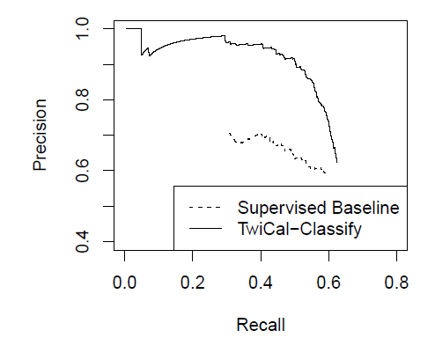
Event Classification Performance

Slide 33
Ranking Events
Twitter users often mention mundane events
What they ate for lunch
Can’t just list by frequency
Entities such as McDonalds would be frequent on most days
Use Statistical Test between entities and dates
Only show if entities appear more than expected

Slide 34
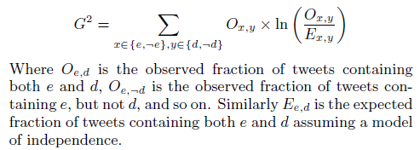
Ranking Events

Slide 35
End-to-end Evaluation
Evaluate end-to-end calendar entries
Collect tweets up to cutoff date
Extract Named Entities, Event Phrases, Temporal Expressions
Classify Event Type
Rank Events
Pick top K events occurring in a 2 week future window
Evaluate Precision

Slide 36
End-to-end System output

Slide 37
End-to-end Evaluation
Ngram Baseline
No Named Entity Recognition
Rely on significance test to rank ngrams
A few extra heuristics (filter out temporal expressions etc…)

Slide 38
Calendar Demo
Extract Named Entities
1% sample of global Twitter stream
2.5 Million / Day
Using NER trained on Labeled Tweets
[Ritter et. al. EMNLP 2011]
Extract and Resolve Temporal Expressions
For example “Next Friday” = 09-09-11
Count Entity/Day co-occurrences
G² Log Likelihood Ratio
Plot Top K Entities for Each Day
_{http://statuscalendar.com}

Slide 39
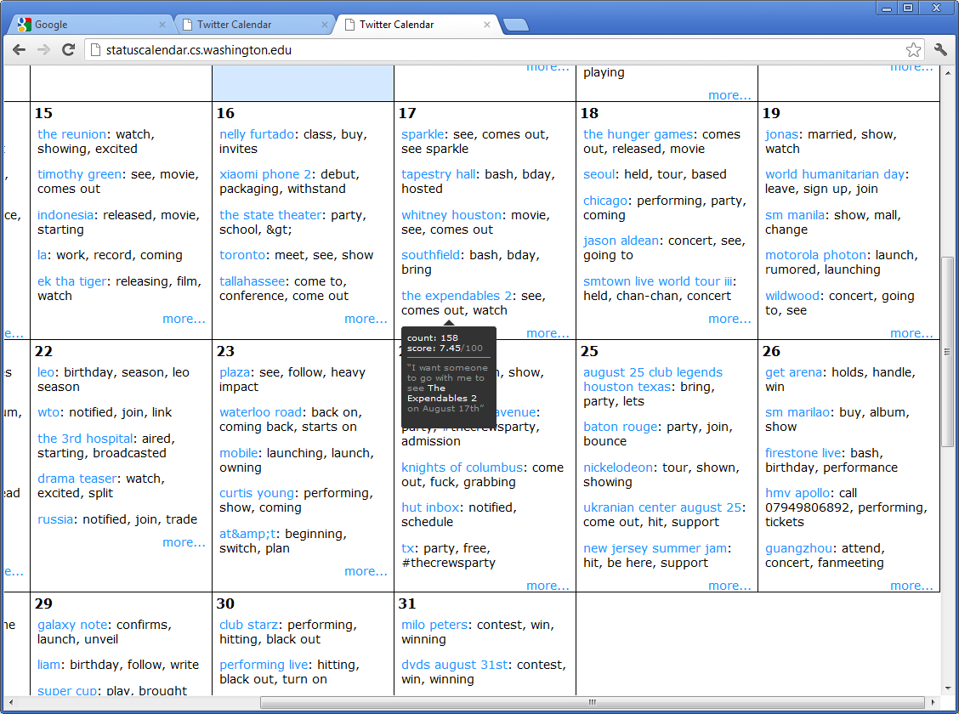
TODO: Screenshots (backup)

Slide 40
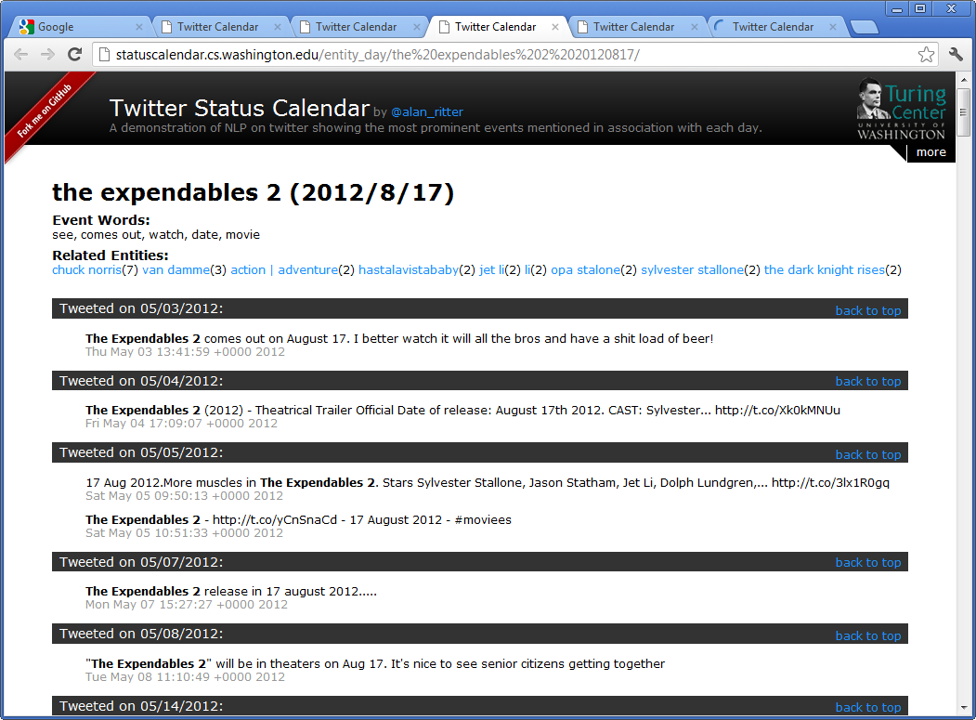

Slide 41
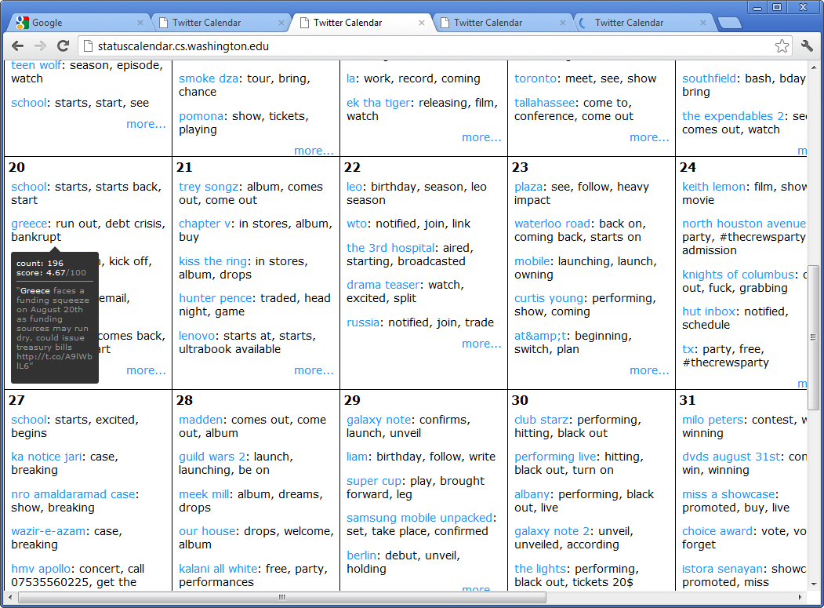

Slide 42
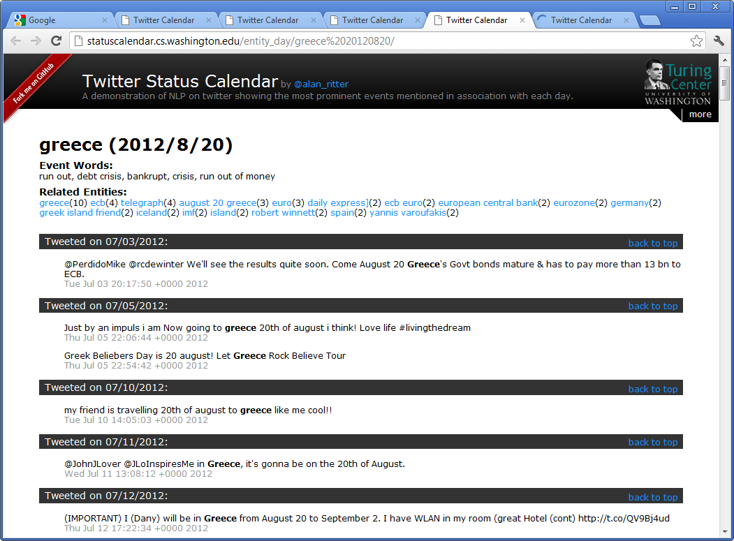

Slide 43
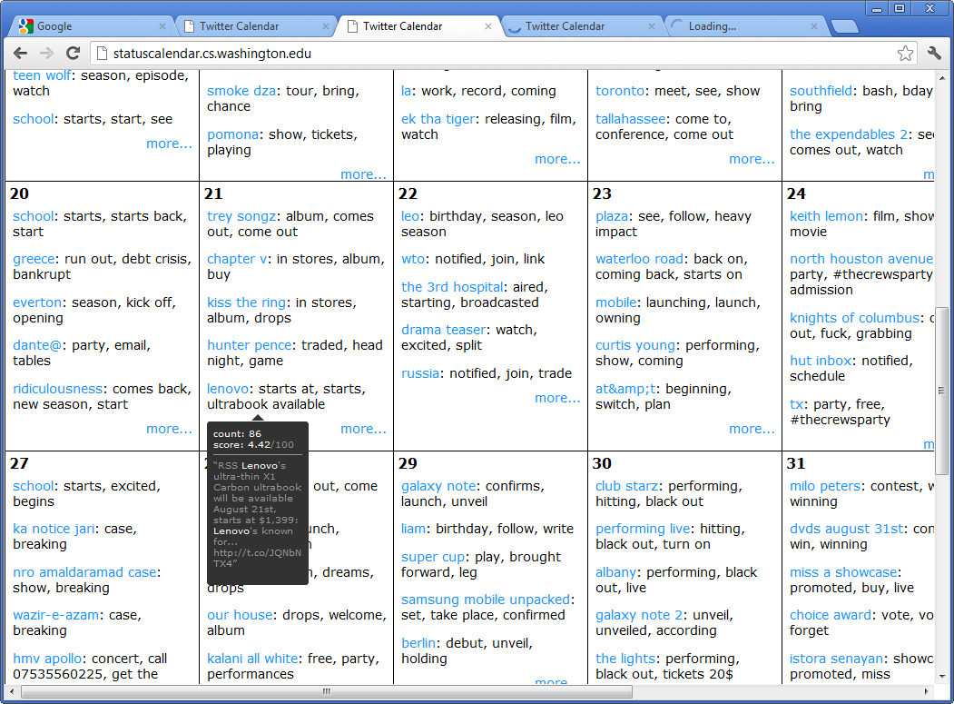

Slide 44
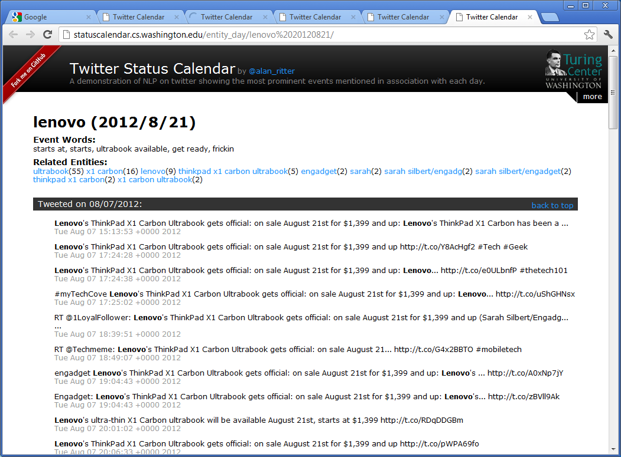

Slide 45
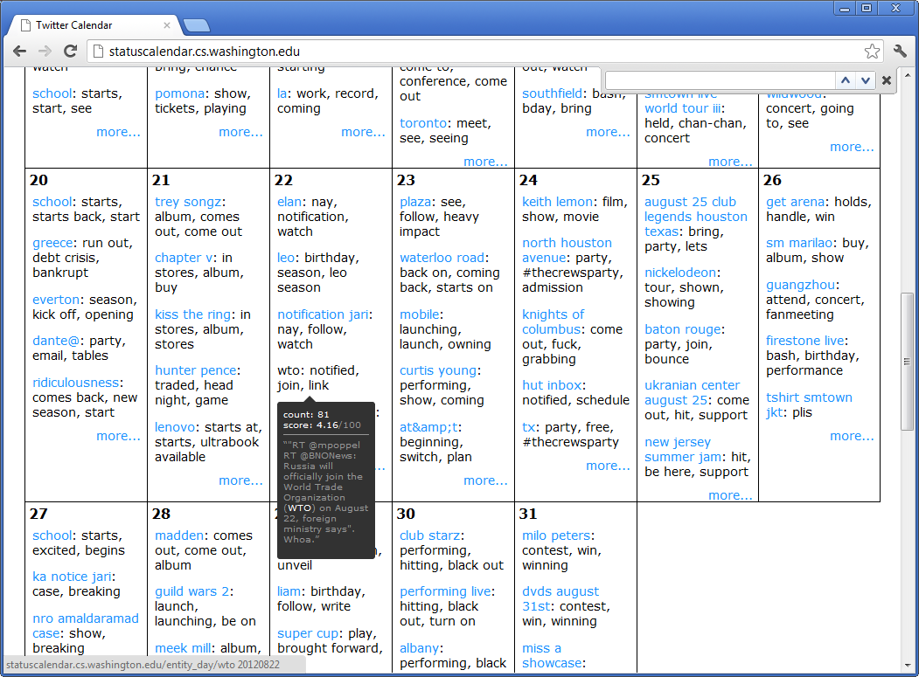

Slide 46
